Slide 1
Rule-based Optimal Control for Autonomous Driving
Team 6
Barış Özmadenci | Aarish Shah | Aditya Paranjape | Quang Le

Slide 2
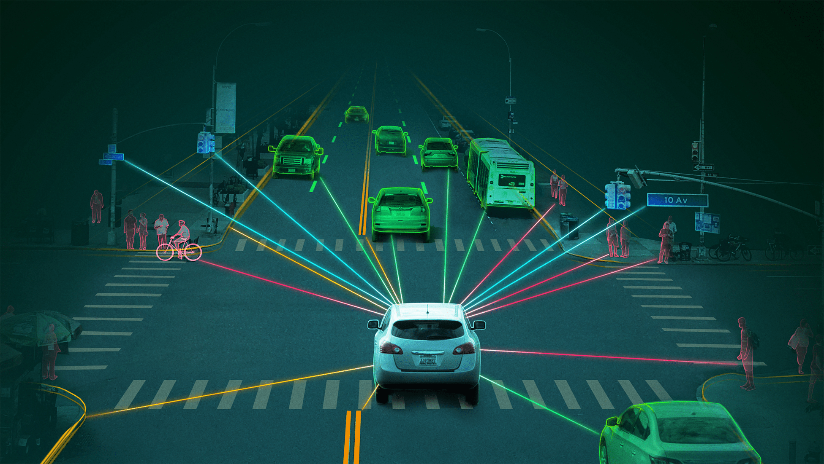
Contents
Introduction to Project
Control Lyapunov Functions & Control Barrier Functions
Problem Formulation
Algorithm - Iterative Approach
Critical Review with paper
Tuning Parameters
Results

Slide 3
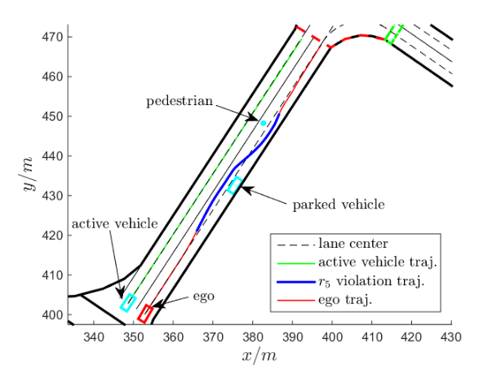
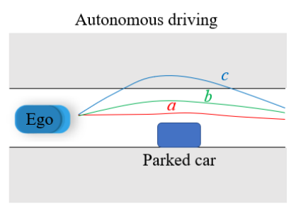
Introduction - Paper Proposal
In this project we implemented an optimal control approach for AV to navigate on road.
While driving on road, certain traffic rules and driving behaviour needs to be demonstrated.
For example, an AV has to avoid collisions with other road users (high priority), drive faster than the minimum speed limit (low priority), and maintain longitudinal clearance with the lead car (medium priority).
Constraints are formulated as Control Lyapunov Functions (CLF) and Control Barrier Functions (CBFs). We formulate iterative rule relaxation according to the priority on the rules
Notes:
Formulate as an optimal control problem, the satisfaction of the
rules and some vehicle limitations are enforced by Control Barrier
Functions (CBF) ,and convergence to desired states is achieved
through Control Lyapunov Functions . To minimize violation of
the set of rules, we formulate iterative rule relaxation according to
the pre-order on the rules.

Slide 4




Control Lyapunov Functions
Consider an affine control system, with following general form:
CLF is designed for reaching a target state (or set)
CLF general form:
 | Lie derivative along f
𝑉(𝑥) | Lyapunov Function
 | CLF Slack Variable
where
𝝐 is a tuning constant. As 𝝐 gets bigger, the CLF constraint imposes stricter condition. It requires 𝑉(𝑥) to decay more quickly.

Slide 5

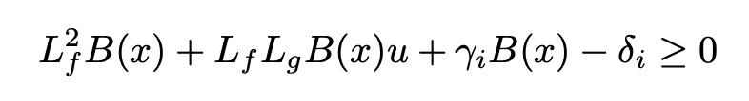


Control Barrier Functions
CBF are designed for designed for avoiding an unsafe set
CBF general form:
HOCBF (2nd order):
where
 | Control Barrier Function
 | CBF Slack Variable

Slide 6
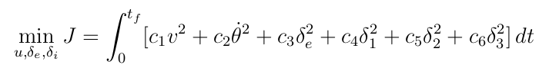
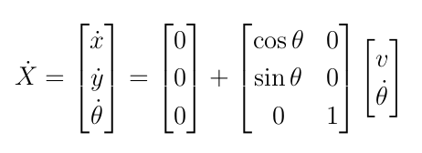
Problem Formulation
1. Dynamics Model:
2. Cost Function:
Affine control system:
v | Linear Velocity
ω | Angular Velocity
𝛿_{e} | CLF Slack Variable
𝛿₁ | Pedestrian Distance CBF Slack Variable
𝛿₂ | Lane-keeping CBF Slack Variable
𝛿₃ | Minimum Velocity CBF Slack Variable
Decision Variables:
Linear velocity
Rate of change of steering angle
CLF slack variable
4. 1st CBF slack variable
5. 2nd CBF slack variable
6. 3rd CBF slack variable
Notes:
Find a control policy that satisfy dynamic system, such that the objective function in is minimized and the trajectory tracking, state constraints and priority structure ,
and control bounds are satisfied

Slide 7
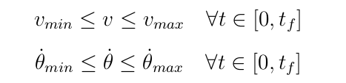

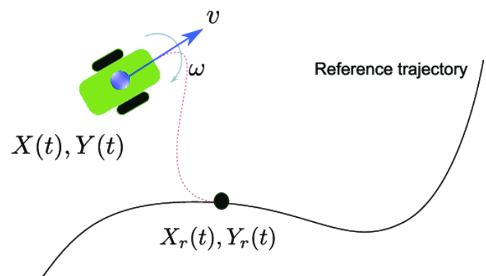
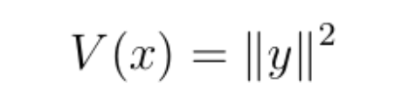
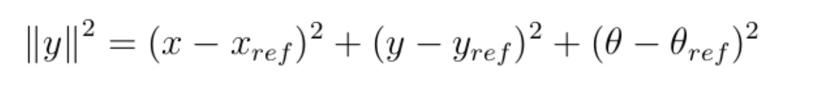
Problem Formulation
3. Regular state and control constraints :
4. CLF:
Error:
CLF Constraint:

Slide 8
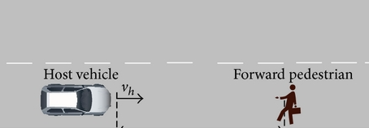


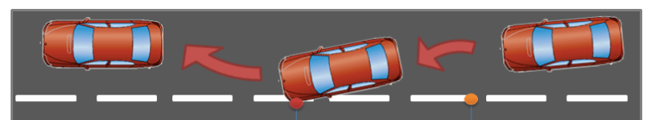



Problem Formulation
5. CBFs
Pedestrian avoidance HOCBF:
Lane keeping CBF:
Minimum Velocity CBF:

Slide 9
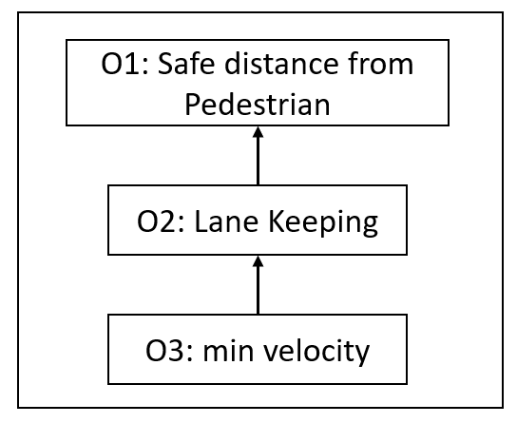
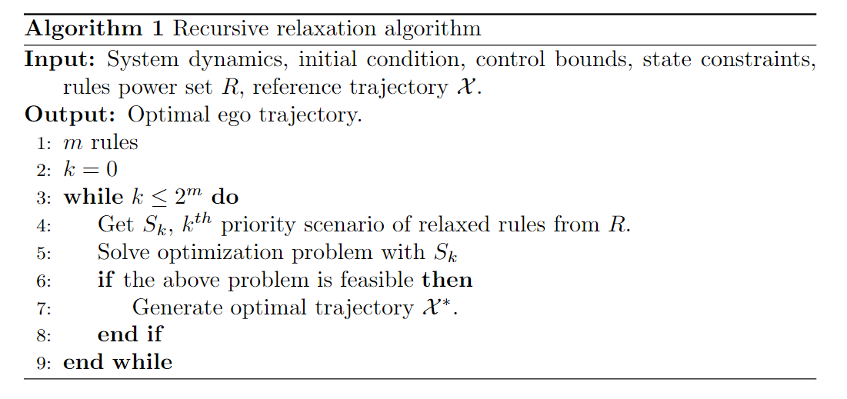
Priority structure Algorithm - Iterative approach
The algorithm iterates through the power set created which specifies which CBFs are relaxed in a priority order.
Power Set

Slide 10
Critical Review of The Paper
In the paper, optimization problem is solved at each time step using QP by fixing the state values whereas we used SQP method by optimizing the whole trajectory via fmincon in MATLAB, due to the existence of nonlinear constraints
The dynamic model and control inputs we employ differ from those outlined in the paper
The CLF and HOCBF equations are structured differently
Our priority rule framework comprises 3 rules as opposed to the rules specified in the paper’s rulebook

Slide 11
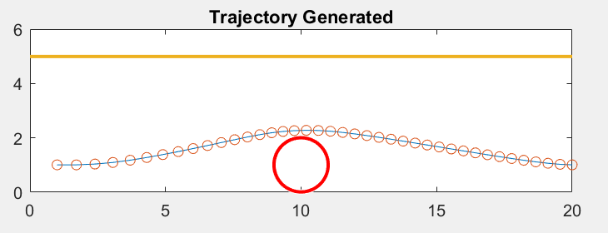
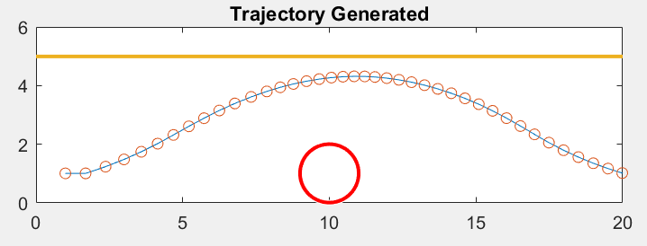
Tuning Parameters
Selecting appropriate hyperparameters is very important. They directly affect the performance of the controller.
γ = 0.1
γ = 0.5
The graph shows the effect of changing hyperparameter γ associated with the Pedestrian safe circle
Inappropriate values of hyperparameters can also render an infeasible solution

Slide 12
Results
We are testing 4 scenarios here:
1. No CBF constraints are relaxed (corresponds to relaxing {∅})
2. Iteratively Lane keeping constraint is relaxed (corresponds to relaxing {O₂})
3. Iteratively Pedestrian constraint is relaxed (corresponds to relaxing {O₁})
4. Iteratively Lane keeping and Pedestrian constraints are relaxed (corresponds to relaxing {O_{1,}O₂})

Slide 13
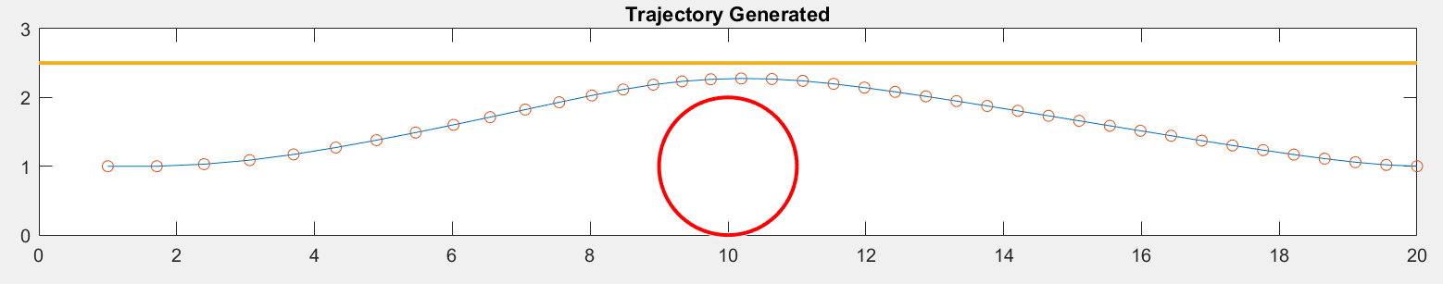
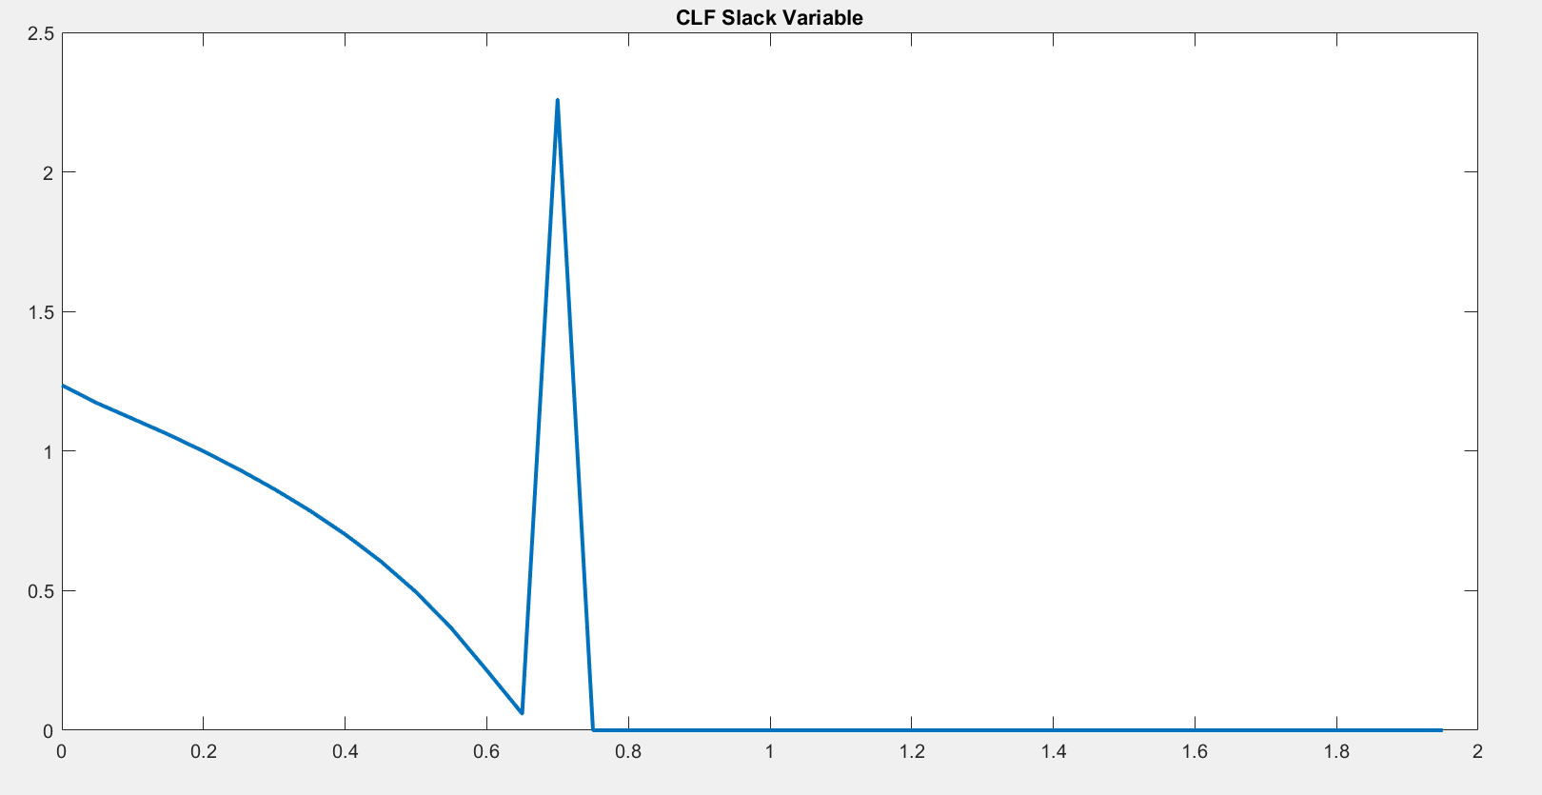
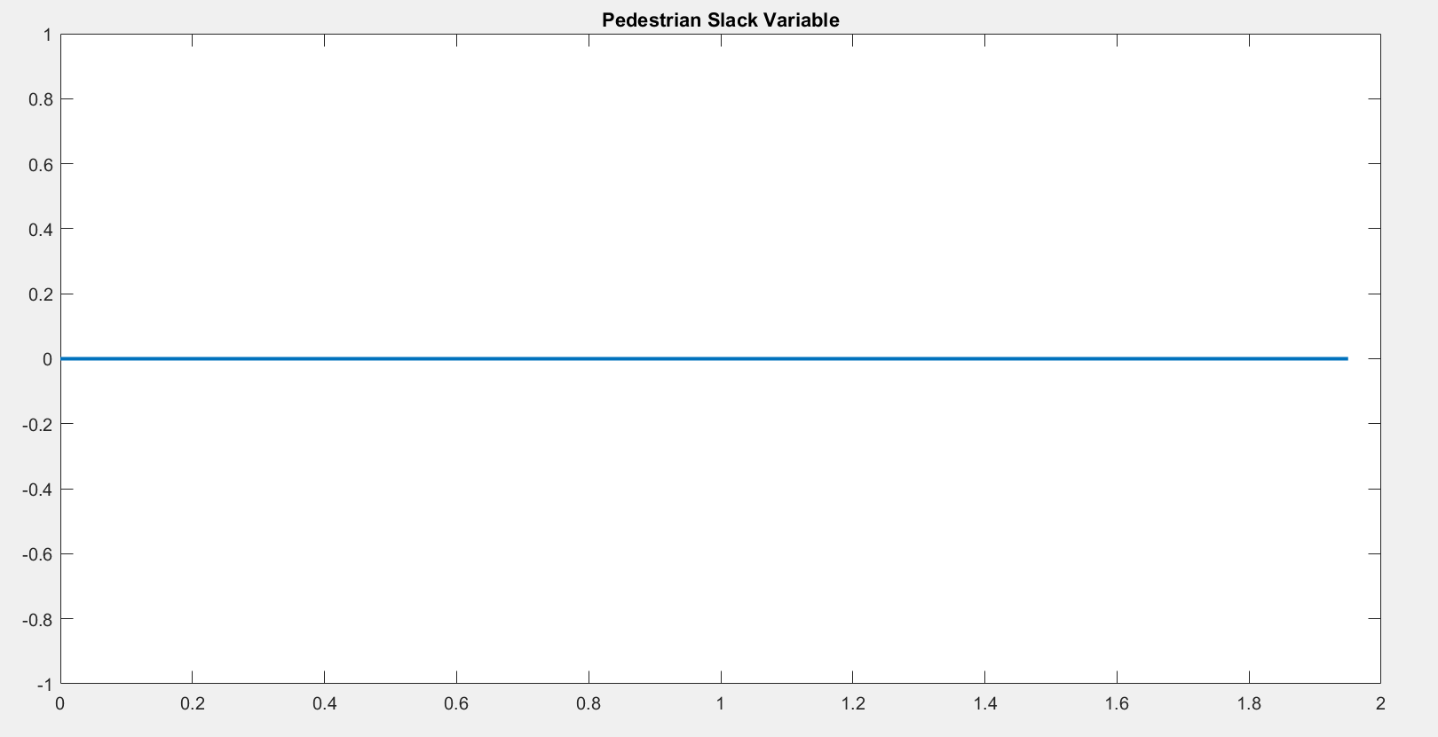
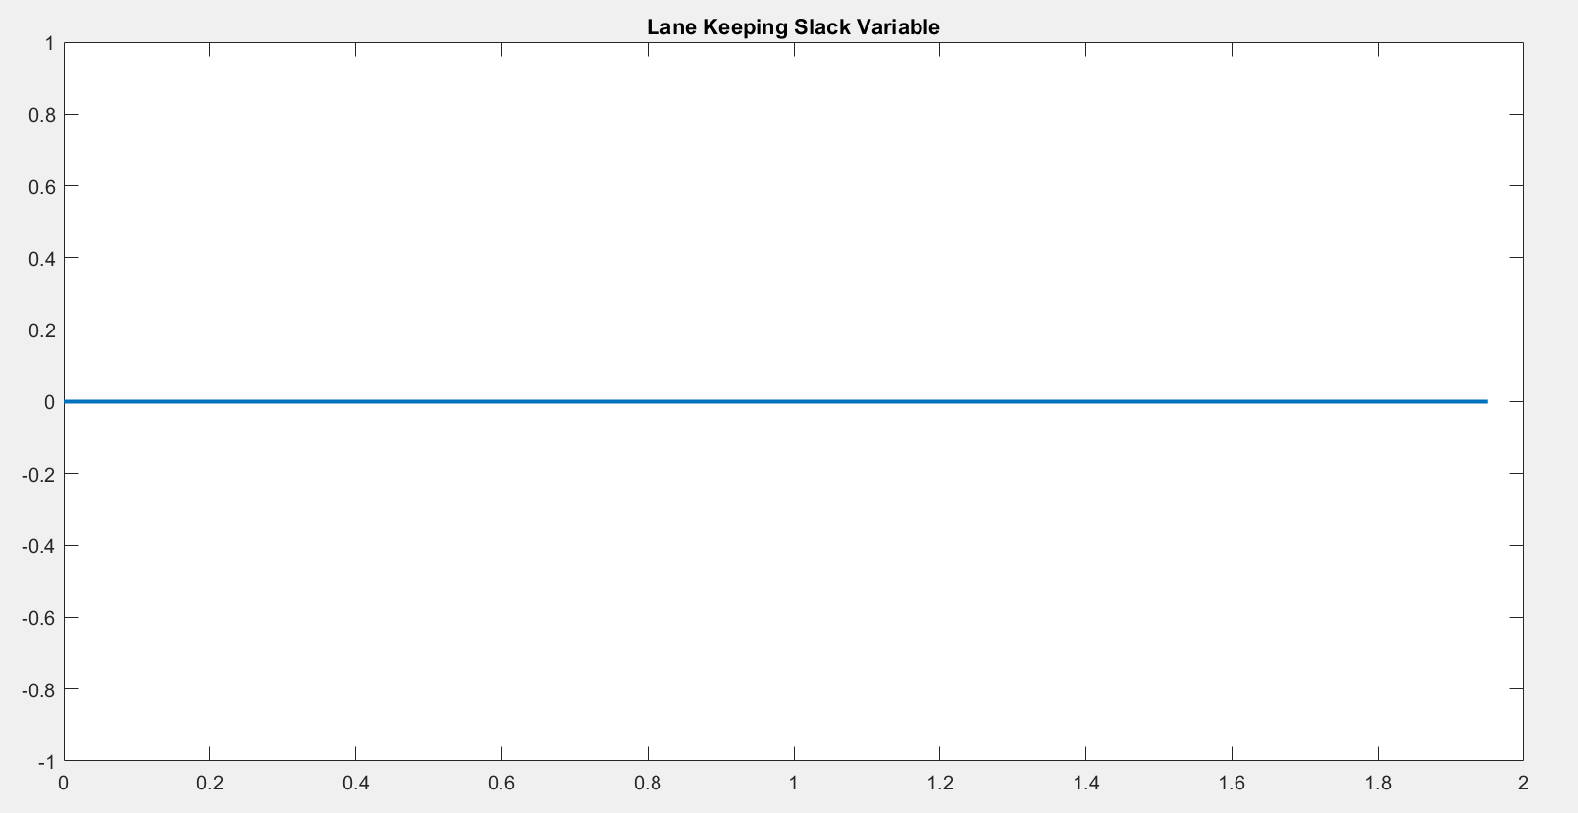
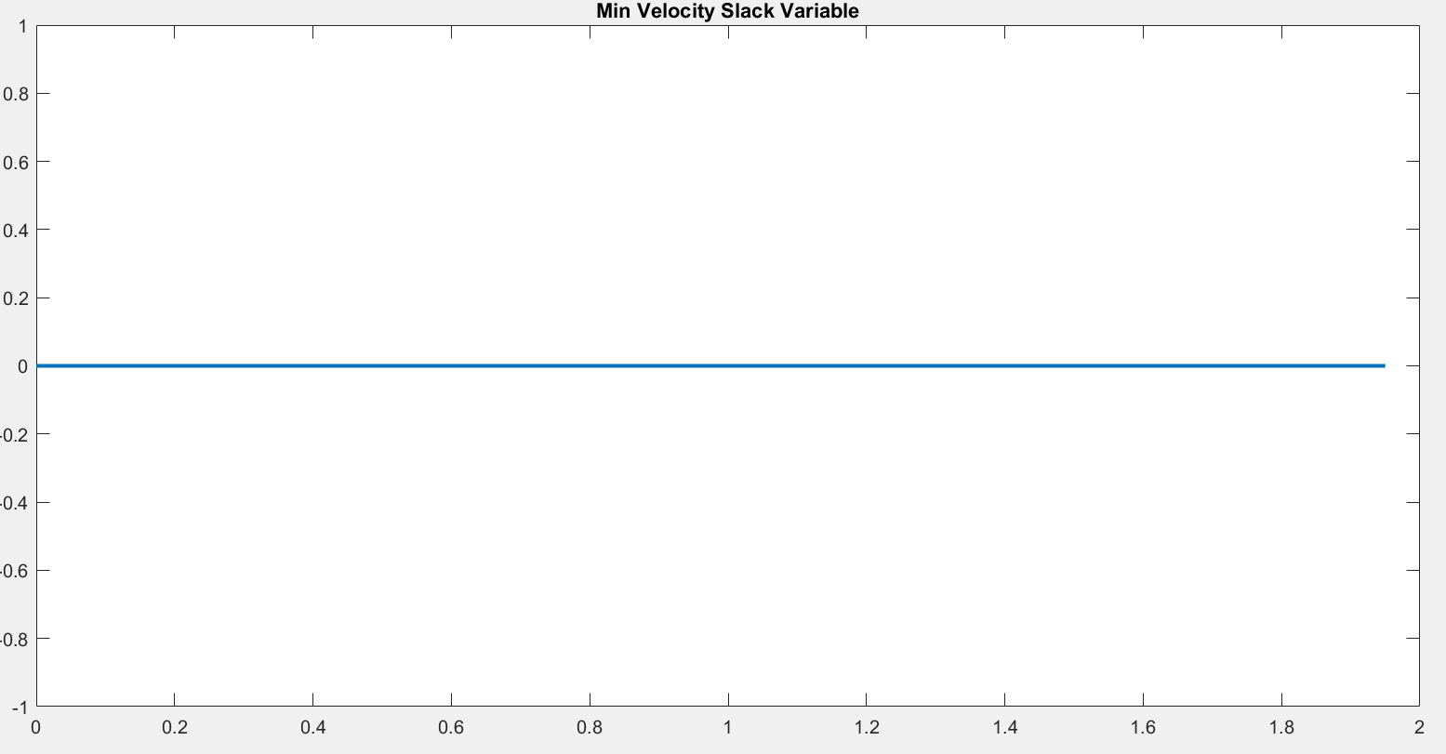
Scenario 1
All constraints act as hard constraints, hence we can see the slack variables for all CBFs to be zero.
The trajectory follows a path between the gap of lane boundary and pedestrian safe circle.
CLF Slack
Pedestrian CBF Slack
Lane-keeping CBF Slack
Minimum velocity CBF Slack

Slide 14
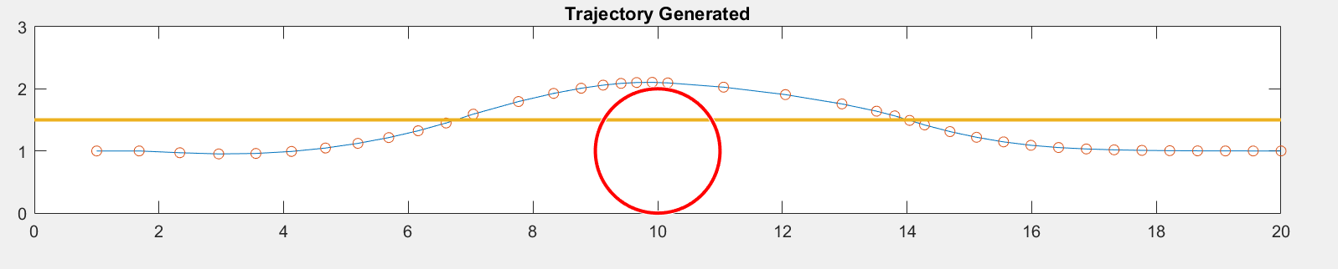
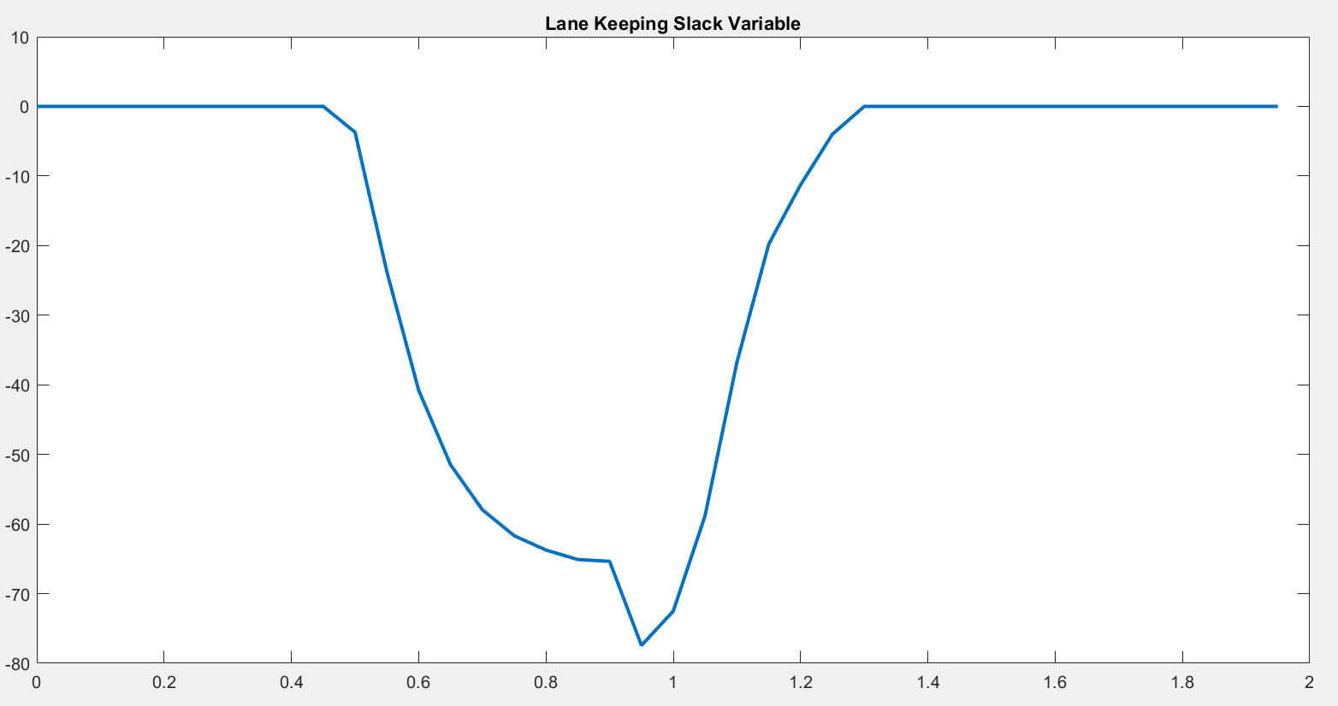
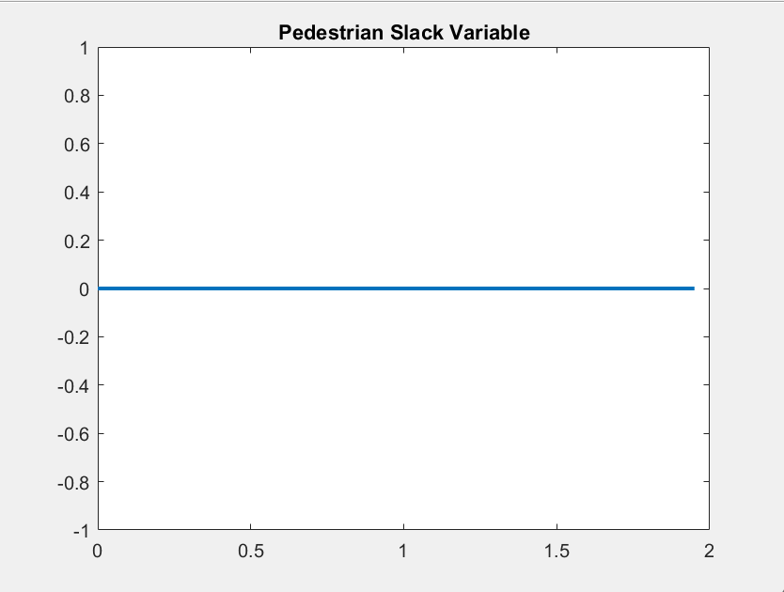
Scenario 2
Iterative power set finds optimal trajectory when lane keeping constraint is relaxed.
Lane keeping constraint is violated without violating the pedestrian and min velocity constraint.
The lane keeping slack variable has a non zero value, but only when constraint is violated.
Lane keeping slack variable is negative, signifying constraint loosening.
Lane-keeping CBF Slack
Pedestrian CBF Slack
Minimum velocity CBF Slack

Slide 15
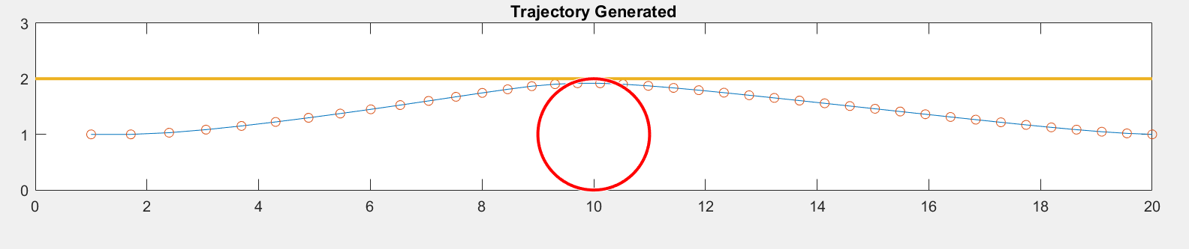
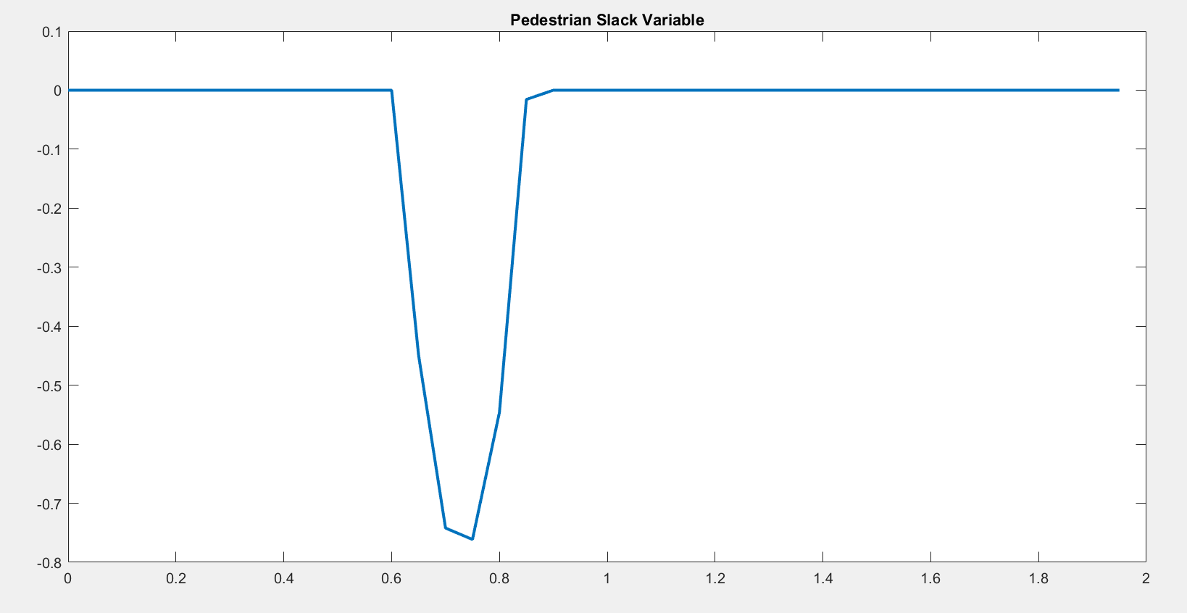
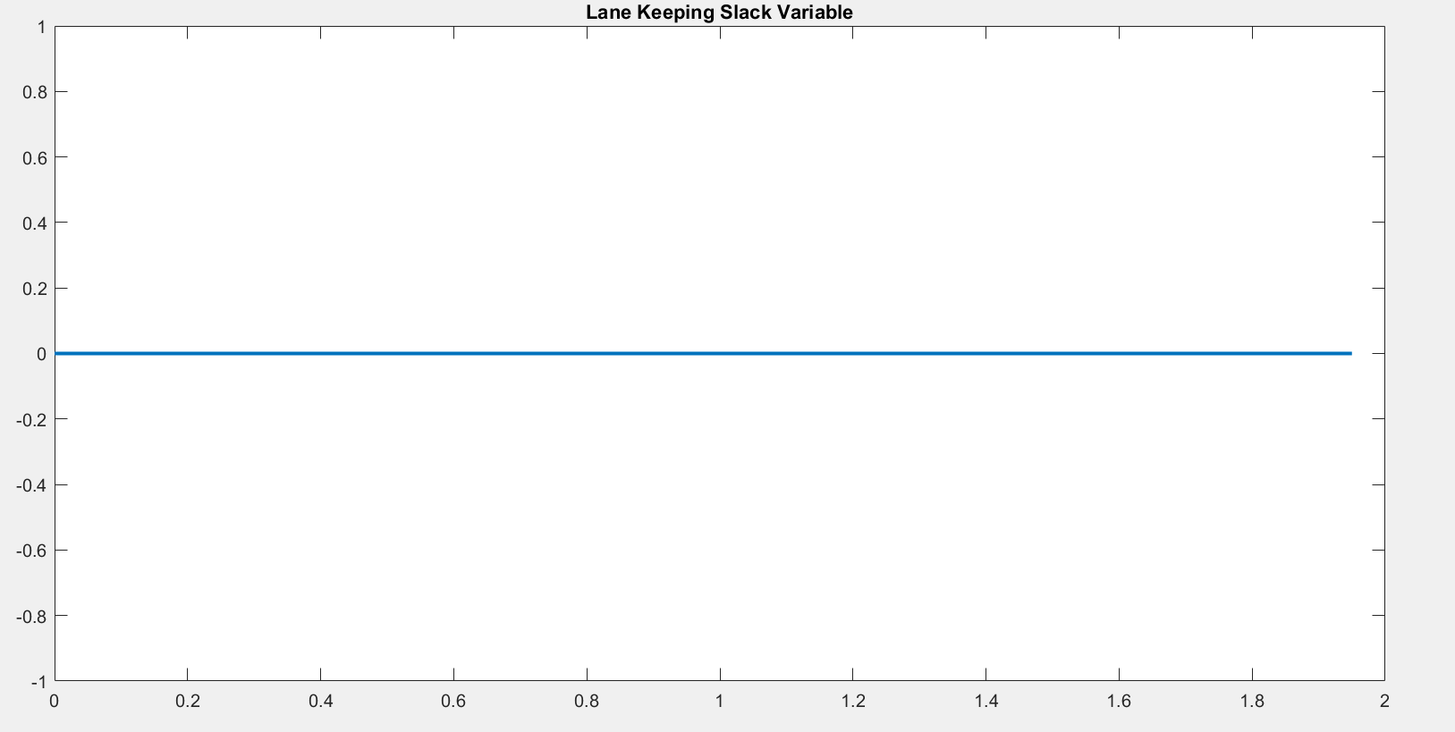
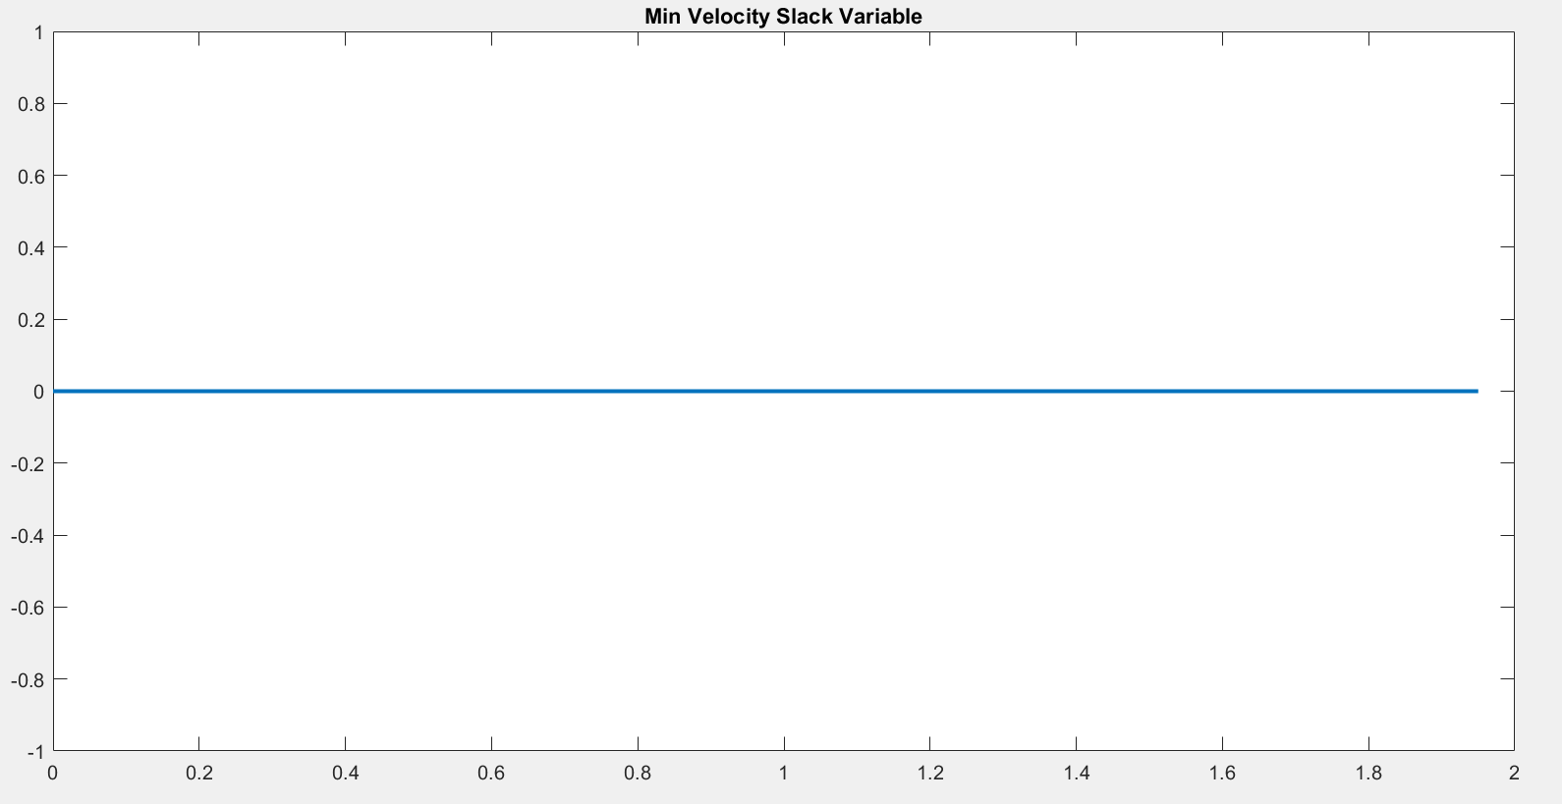
Scenario 3
Here the lane keeping is made a hard constraint for test case purposes.
We can see that the trajectory violates the pedestrian safe circle, since there is no other feasible trajectory.
However, it tries to stay as far away as possible from the pedestrian to minimize constraint violation.
Pedestrian distance slack variable is negative, signifying constraint loosening.
Pedestrian CBF Slack
Lane-keeping CBF Slack
Minimum velocity CBF Slack

Slide 16
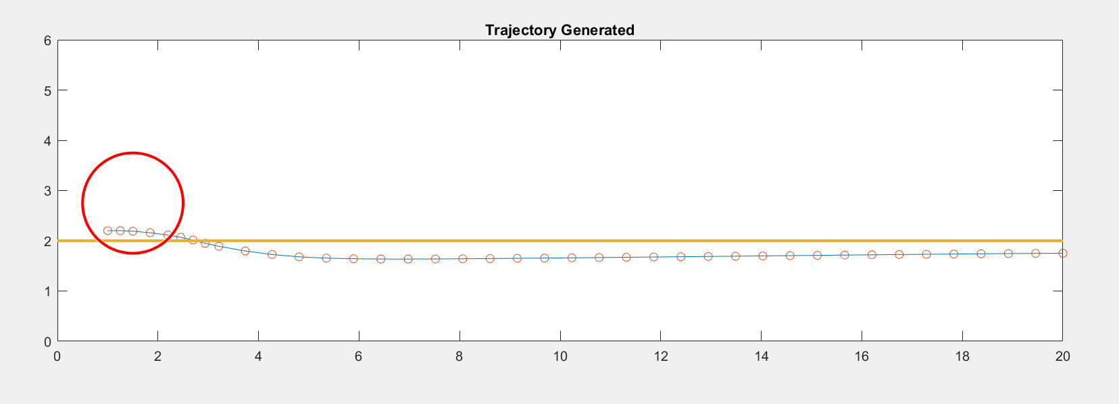
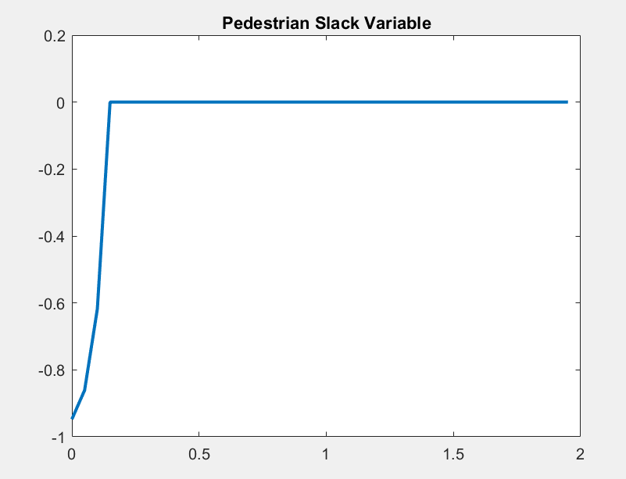
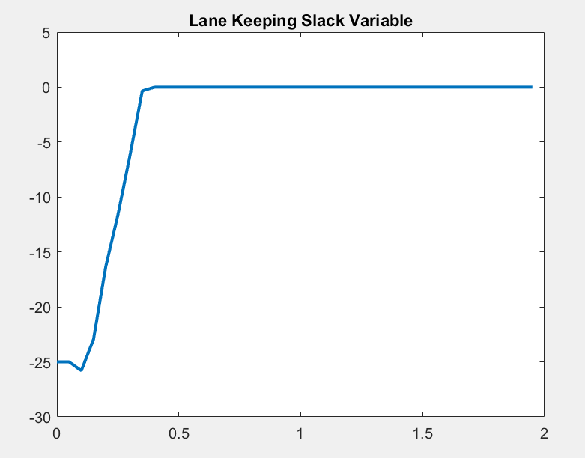
Scenario 4
Here both lane keeping and pedestrian constraints are relaxed at the starting point.
We can see that the trajectory tries to move out of the circle as fast as possible.
However, it tries to exit the pedestrian circle and go inside the lane as soon as possible to minimize constraint violation.
Pedestrian CBF Slack
Lane-keeping CBF Slack

Slide 17
Thank you

Slide 18
References
https://researchleap.com/research-in-autonomous-driving-a-historic-bibliometric-view-of-the-research-development-in-autonomous-driving/
https://github.com/HybridRobotics/CBF-CLF-Helper
https://www.hindawi.com/journals/tswj/2014/218246/
https://www.researchgate.net/figure/Basic-idea-of-trajectory-tracking-in-a-differential-drive-mobile-robot_fig1_338722172
Xiao, W., Mehdipour, N., Collin, A., Bin-Nun, A. Y., Frazzoli, E., Tebbens, R. D., & Belta, C. (2021). Rule-based optimal control for autonomous driving. Proceedings of the ACM/IEEE 12th International Conference on Cyber-Physical Systems. https://doi.org/10.1145/3450267.3450542

Slide 19
Introduction
CLF and CBF based methods are effective in many safety-critical control problems. Generally, CLF are designed for reaching a target state (or set) and CBF are designed for avoiding an unsafe set.
⇒ Formulate quadratic programs (QPs) that could be solved in real time
Given the relative priorities of these specifications, a reasonable AV behavior would be to avoid a collision with the pedestrian or other vehicles (high priority), and instead violate low or medium priority rules.
An iterative procedure that uses the rule priority to determine a control strategy that minimizes rule violation globally

Slide 20


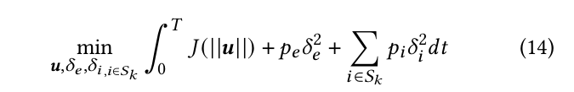
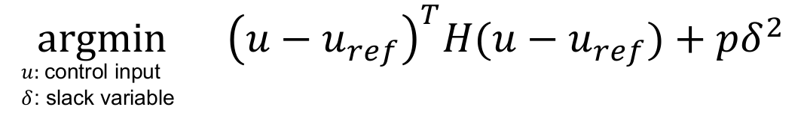
2.1. Problem Formulation - Cost function
Explain variables
Reformulate
Simple version:

Slide 21
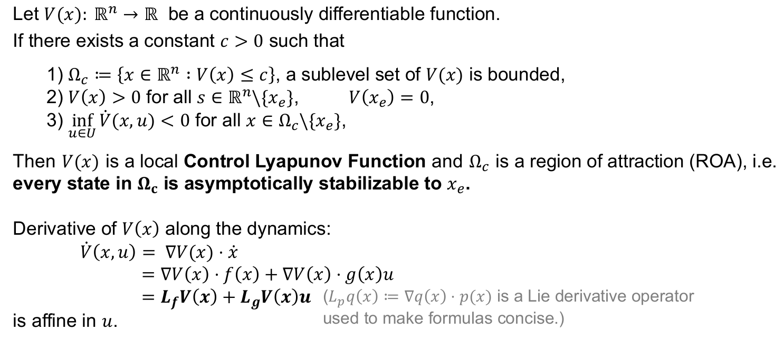
2.4. Problem Formulation - CLF

Slide 22
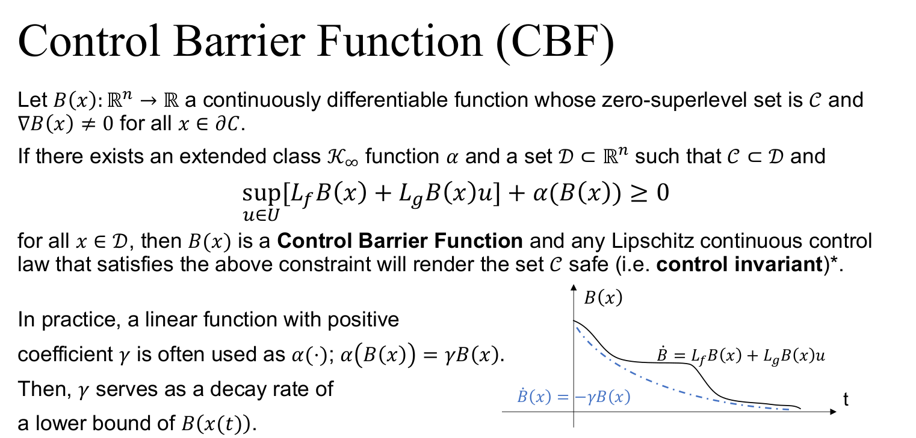
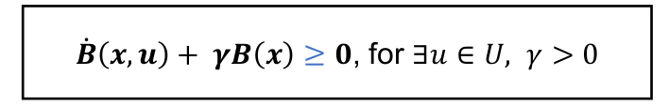
2.3. Problem Formulation - HOCBF

Slide 23

2.5. Problem Formulation - Final statement
Find a control policy that satisfy dynamic system (1), such that the objective function in (7) is minimized and the trajectory tracking, state constraints (8) and priority structure ,
and control bounds (2) are satisfied.

Slide 24
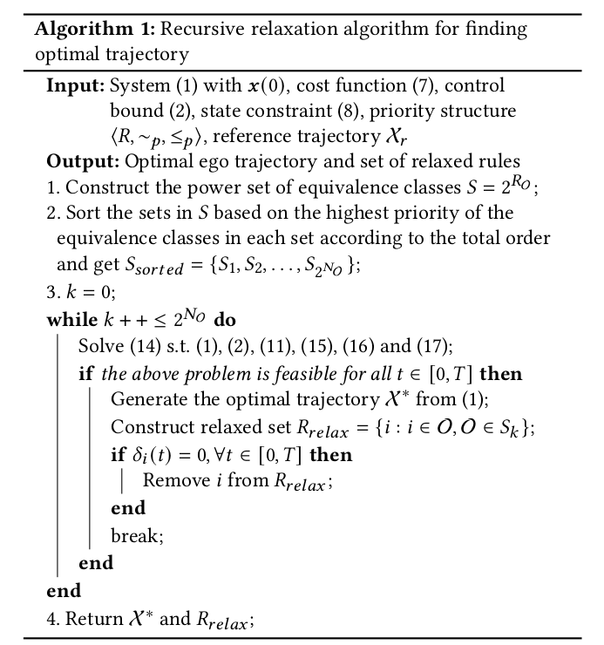
3. Algorithm of project - Iterative approach

Slide 25

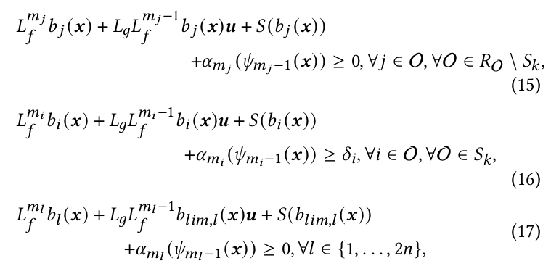
3. Algorithm of project - Iterative approach

Slide 26
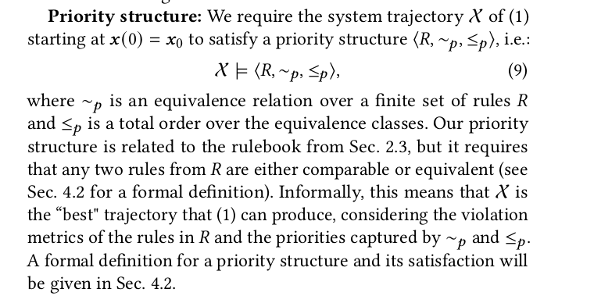
Proposal of the paper
Content

Slide 27
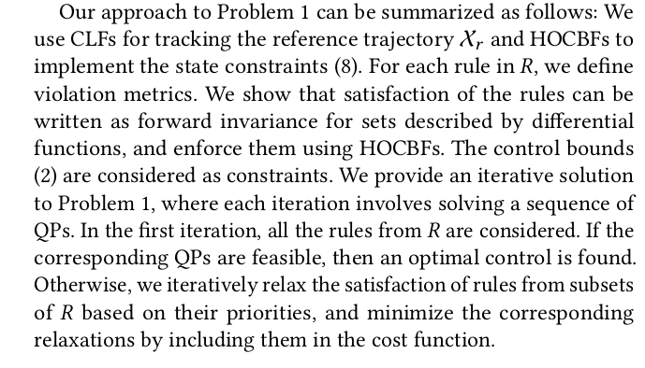
Proposal of the paper
Content

Slide 28
Points of the proposal
use CLFs for tracking the reference trajectory X and HOCBFs to implement the state constraints (8)
For each rule in 𝑅, we define violation metrics. We show that satisfaction of the rules can be written as forward invariance for sets described by differential functions, and enforce them using HOCBF ???
The control bounds (2) are considered as constraints
We provide an iterative solution to Problem 1, where each iteration involves solving a sequence of QPs. In the first iteration, all the rules from 𝑅 are considered. If the corresponding QPs are feasible, then an optimal control is found. Otherwise, we iteratively relax the satisfaction of rules from subsets of 𝑅 based on their priorities, and minimize the corresponding relaxations by including them in the cost function.

Slide 29
Sec 4 : Rules and priority structures
implemented through selection of a maximum or a minimum, integration over time, summation over instances, or by using general 𝐿 𝑝 norms.
A zero value for a violation score shows satisfaction of the rule.
We divide the set of rules into two categories: (1) clearance rules - safety relevant rules enforcing that ego maintains a minimal distance to other traffic participants and to the side of the road or lane (2) non-clearance rules - rules that that are not contained in the first category, such as speed limit rules.
Provide a general methodology to express clearance rules as inequalities involving differentiable functions, which will allow us to enforce their satisfaction using HOCBFs

Slide 30
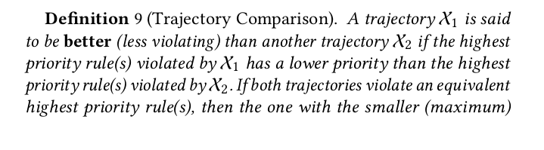

Sec 4 : Rules and priority structures
Given a priority structure ⟨𝑅, ∼ 𝑝 , ≤ 𝑝 ⟩, we can assign numerical (integer) priorities to the rules. We assign priority 1 to the equivalence class with the lowest priority, priority 2 to the next one and so on. The rules inside an equivalence class inherit the priority from their equivalence class. Given a priority structure ⟨𝑅, ∼ 𝑝 , ≤ 𝑝 ⟩ and violation scores for the rules in 𝑅, we can compare trajectories
How to compare trajectory

Slide 31
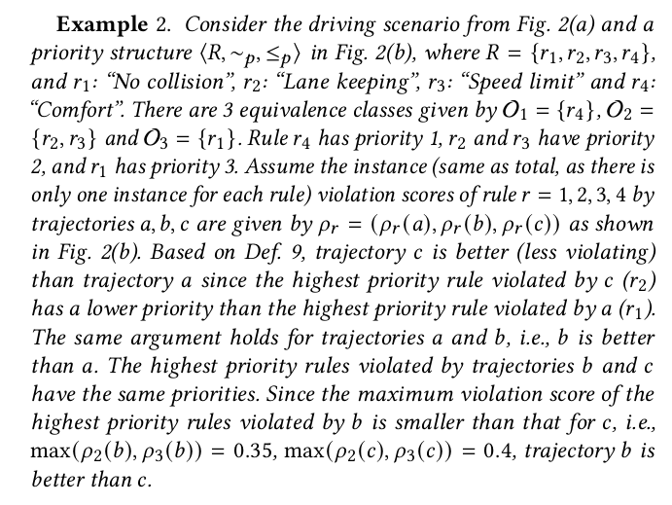
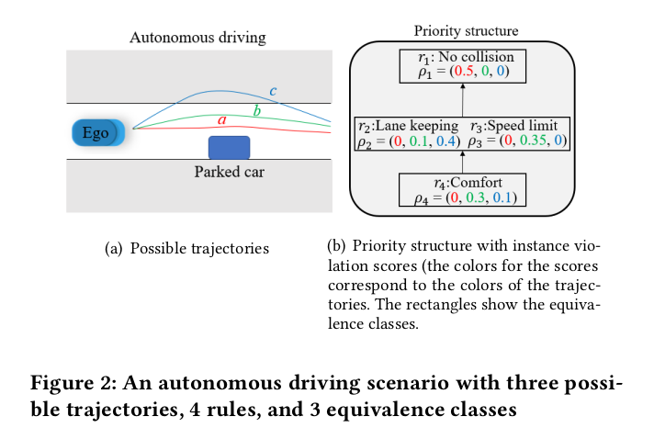
Sec 4 : Rules and priority structures
Great example

Slide 32
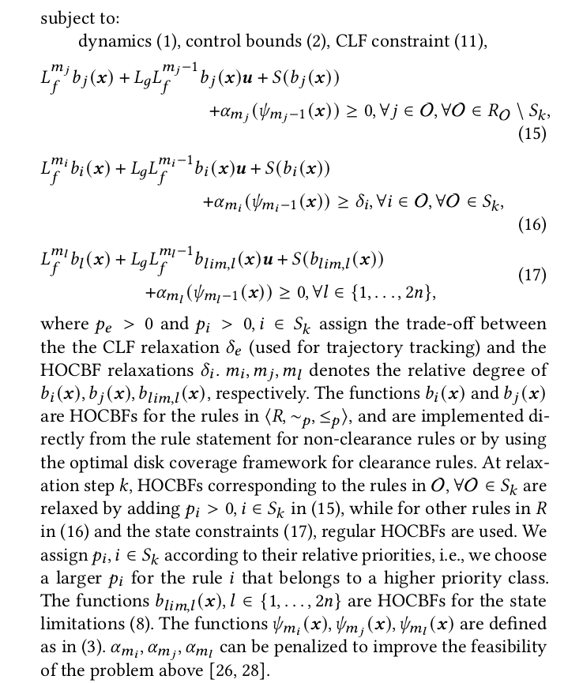
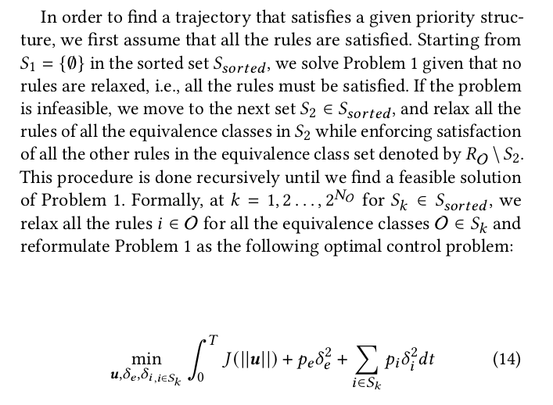
Sec 5 : How to solve proposed problem 1
5.3: Optimal Control
Great example

Slide 33
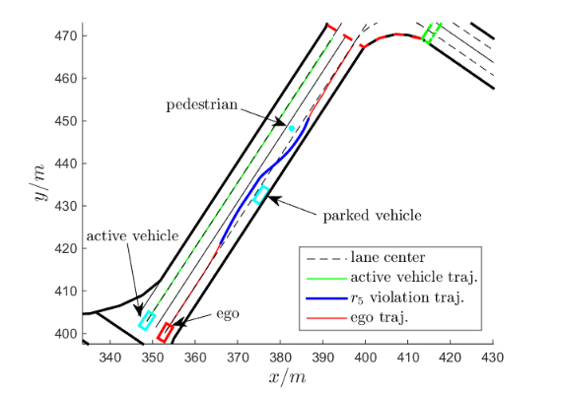
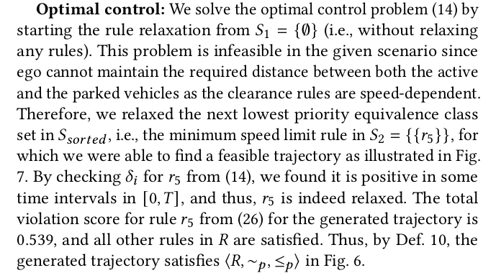
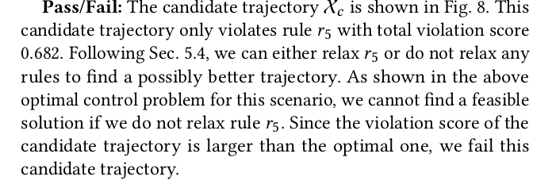
Verified effectiveness of the proposal - Case study
Scenario 1

Slide 34
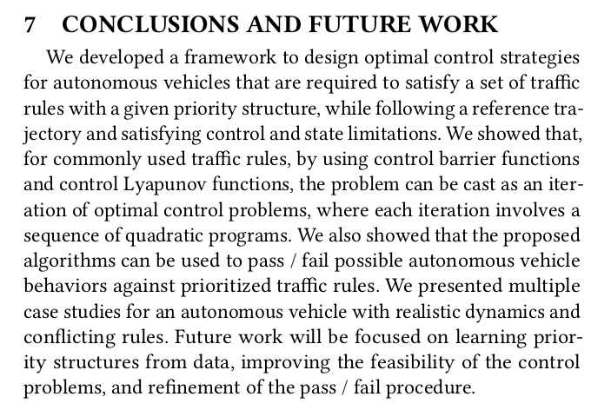
Discussions/ Remaining problems

Slide 35
